Slide 1
Myo-Powered Brick Breaker Game
By : Laura Ogba & TIANLE SHU

Slide 2


Original Game
Our Original Game Was fruit Slicer.
Had Troubles with coordination.
Myo was Difficult to detect the slicing of fruits.

Slide 3
About Brick Breaker
Brick Breaker (platformer) is a Breakout clone in which the player must smash a wall of bricks by deflecting a bouncing ball with a paddle. The paddle may move horizontally and is controlled with the BlackBerry's trackwheel, the computer's mouse or the touch of a finger (in the case of touchscreen). When all the bricks have been destroyed, the player advances to a new level. There are 34 levels. There are many versions of brick breaker, some in which you can shoot flaming fireballs or play with more than one ball if the player gets a power up.

Slide 4
Myo Overview
Wearable technology
Uses mixture of accelerometer, magnetometer and gyroscope to detect arm motion.
Detects electrical signals from forearm muscles to recognise gestures.
5 standard gestures:
Close fist, spread fingers, wave left, wave right & double tap

Slide 5
Myo Review
Advantages:
Disadvantages:
Novel item.
Decent motion tracking
Not much else
Uncomfortable for long usage periods
Constant need to re-sync device.
Unpredictable behaviour when battery is low

Slide 6

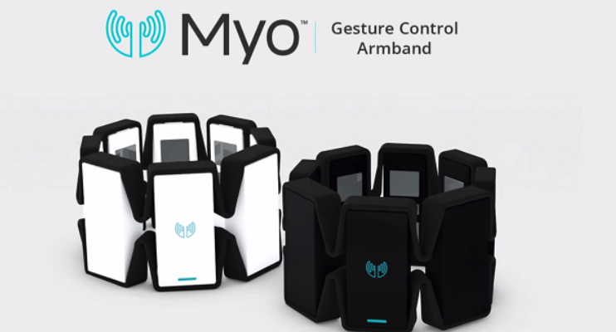
Technology Used
Unity – Using C#
Myo – Using Myo SDK

Slide 7
Project Architecture
Bricks
Ball
CameraScript
PaddleScript & BallScript
Gesture Control
Gesture Control
MYO SDK

Slide 8
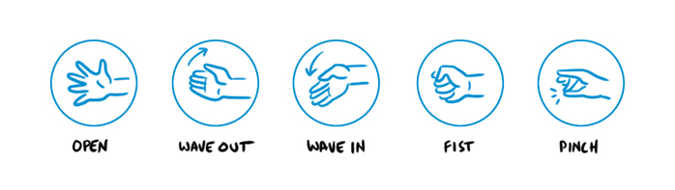
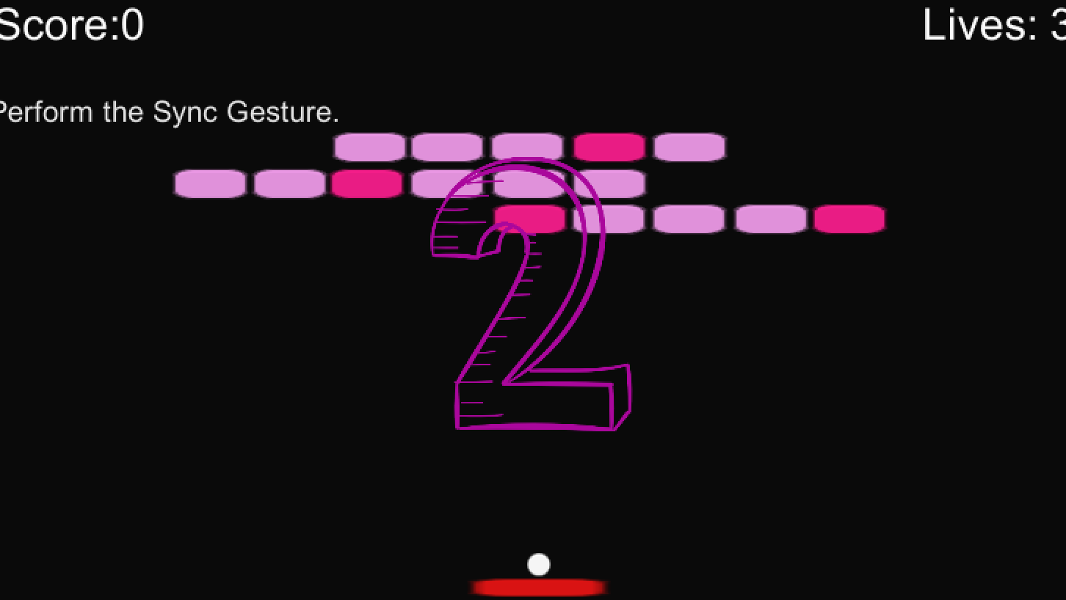
Gestures
Fist: release ball.
Wave in: turn left.
Wave out: turn right.

Slide 9
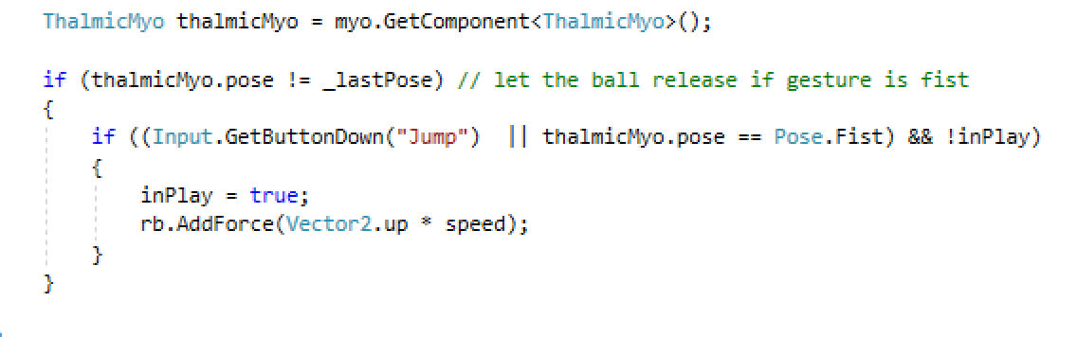
If the game is playing , after 3 seconds and gesture is fist --- ball will released

Slide 10
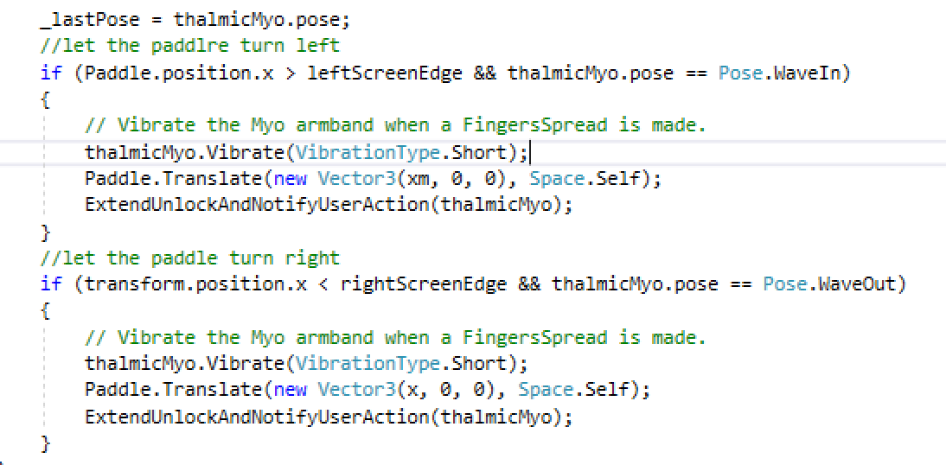
Make the paddle turn left or right use different gesture and also check the paddle if in the screen.

Slide 11
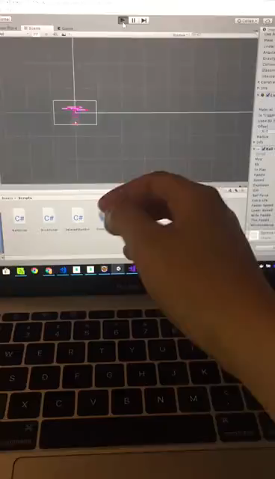
DeMO

Slide 12
Any Questions?

